Slide 1
Simulation Project Effect of Two Patient Triage Policies on Workload of Emergency Teams
Rahman Khorramfar
April 2018

Slide 2
Introduction
Triage is the process of determining the priority of patients' treatments based on the severity of their condition.
Triage may result in determining the order and priority of emergency treatment.

Slide 3
Goal of the Project
Determine the triage policy that distributes workloads more equitably among provider teams.
Use simulation to compare variance of each policy.

Slide 4
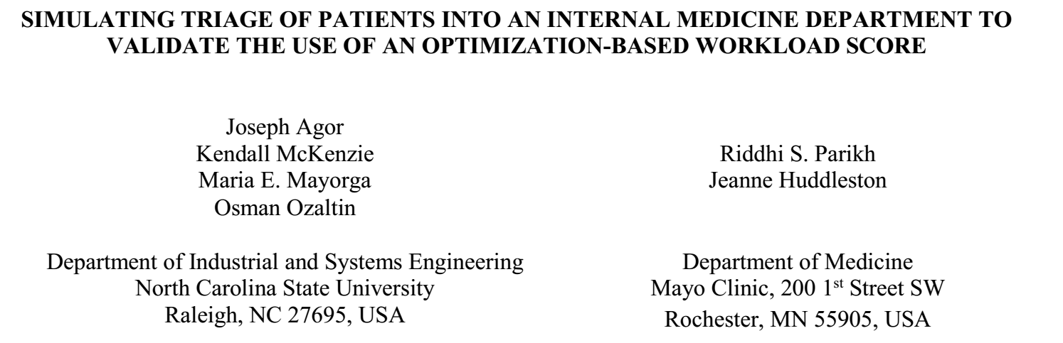
Why Patient Triage

Slide 5
Problem Setting
Simulation to represent the movement of patients and their associated workload.
Model similar to that of the Paper.
ED consist of 11 provider teams consisting of Medical Doctor (MD), physician’s assistant (PA), and clinical assistant (CA).
Patients have six distinct types.
Arrivals follow NHPP with different rates.
Different workload for every patient type.

Slide 6

Problem Setting

Slide 7

Problem Setting

Slide 8
Simulation Model
Patients are assigned to a provider team by the Medical Officer of the Day (MOD).
They get treatment on the next day.
Each day there are number of patients with known arrival times and workloads.
Each of the provider teams start their work as a single server system.
Workload of a team is defined as the total time they spend to discharge all their patients.

Slide 9
Simulation Model: Schematic view

Slide 10
Triage Policies
Triage by Census: assign newly-arrived patient to the team with least census
Triage by Workload: assign newly-arrived patient to the team with least Workload

Slide 11
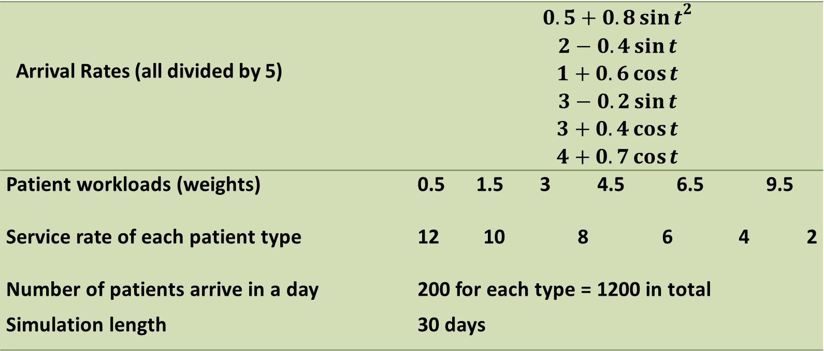
Simulation Data
Arrival Rates (all divided by 5) | $$0.5+{0.8\sin{t}}^{2}$$ $$2−0.4\sin{t}$$ $$1+0.6\cos{t}$$ $$3−0.2\sin{t}$$ $$3+0.4\cos{t}$$ $$4+0.7\cos{t}$$
Patient workloads (weights) | 0.5 1.5 3 4.5 6.5 9.5
Service rate of each patient type | 12 10 8 6 4 2
Number of patients arrive in a day | 200 for each type = 1200 in total
Simulation length | 30 days

Slide 12
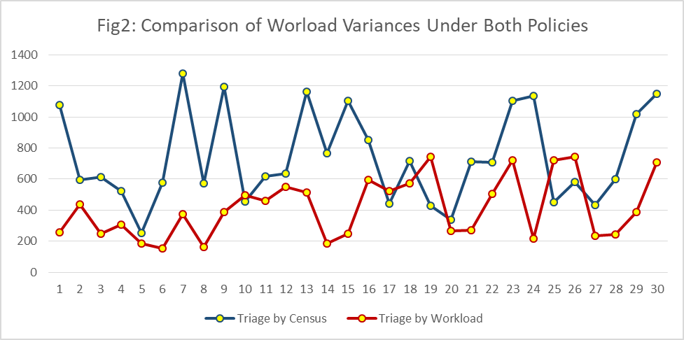
Simulation Results: Variance of Workload Among teams
Total Variance in Census-based Policy: 22102
Total Variance in Workload-based Policy: 12431 43% reduction

Slide 13
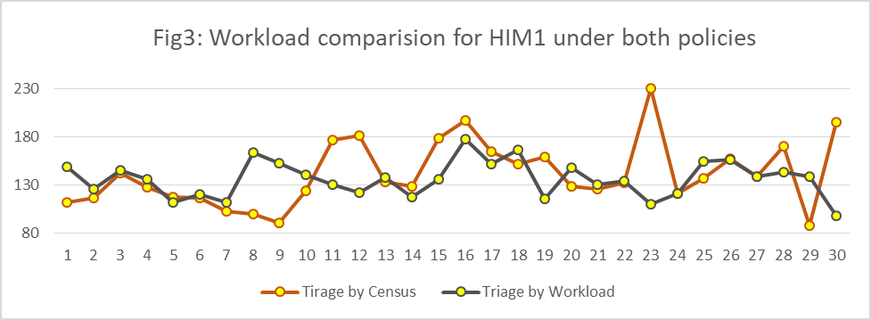
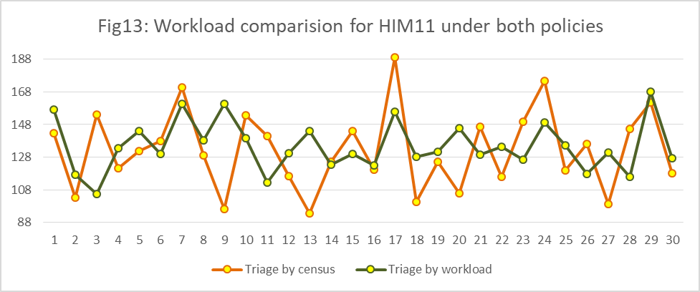
Simulation Results: consistency of Workload for a team

Slide 14
Conclusion
The project is about patient triage in EDs.
Inspired by actual model.
Simulation of two policies: Triage by Census and Triage by Workload.
Triage by Workload is better policy in terms of more equitable distribution of workload among provider teams.
It also obtains more consistent schedule for teams.

